Slide 1
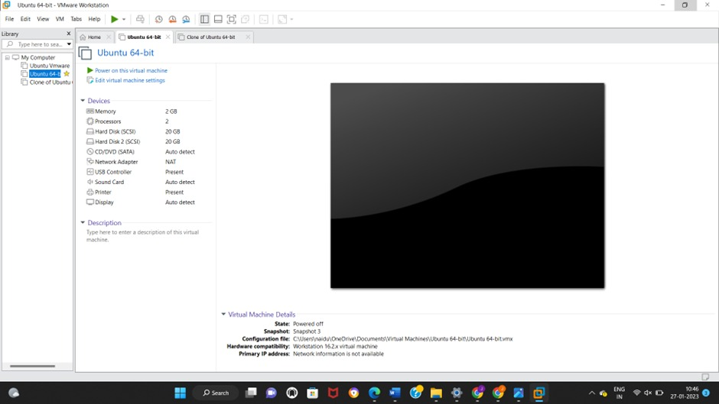
EXPERIMENT :6 Demonstrate virtualization by Installing Type-2 Hypervisor in your device, create and configure VM image with a Host Operating system (Either Windows/Linux).

